Slide 1

Library Management Program
GROUP MEMBER:
Chawin Sungwalngern
Daniele Kovaci
Samrat Gundpatil
Enkel Cerri
PROGRAMMING LAB II
Date: 06/02/2023
SRH Berlin University of Applied Science

Slide 2
Agenda
Introduction
Criteria
Timeline
Issue
Program Demonstration
SRH Berlin University of Applied Science

Slide 3
Objective
The main objective of our Project is to manage the details of Books, Users and issued books
tracking.
SRH Berlin University of Applied Science

Slide 4
Criteria
Library Admin:
Login
Insert, modify and remove books
Accept/Reject a new user
a. Create one time password
Delete user account
View all the book issuing and returning history
a. Based on dates
b. Based on users
Search books with categories
Search user with names
Users:
Account opening - Registration
User login
Book issuing request
Show if the searched book is available
Show when the book will be available next
View own issuing and returning history
Only issued ones but not returned
Issued and returned ones
View and edit account details
Change password/pin
SRH Berlin University of Applied Science

Slide 5
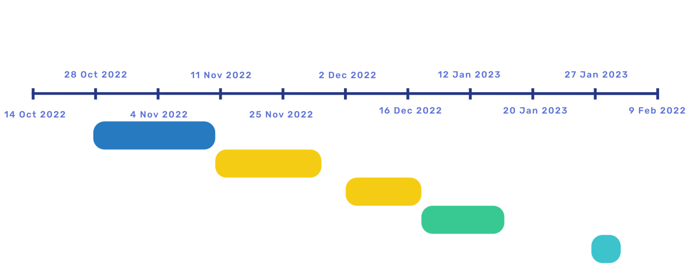
Timeline
Planing
Two weeks
Protrotype 1
Two weeks
Protrotype 2
5days
Final Program
Ppt
1 Day
Criteria updated
Exam
SRH Berlin University of Applied Science

Slide 6
Issues
Updated of new criteria
Delete function delete all data in txt.file instead of target input
Too many functions
Forgot to implement 2 search functions(by date and by username)
SRH Berlin University of Applied Science

Slide 7
Program Demonstration
SRH Berlin University of Applied Science

Slide 8
Q&A& Thank you for listening
SRH Berlin University of Applied Science

